Slide 1
Drug Review Sentiment Analysis
Team 3: Haotian Wu, Miao Fang, Jiawei Du
MScA 32009
Our Project Github: https://github.com/whtwht97/Health-Analytics/

Slide 2
01
02
03
04
Background
Data Processing
EDA
Feature Engineering
Healthcare Problem
Existing & Future Solutions
Data Overview
Model Building
Conclusion
Model Overview
Model Selection
Healthcare Impact
Future Work

Slide 3
01
Background
Healthcare Problem
Existing & Future Solutions
Data Overview

Slide 4
Healthcare Problem
Evaluation on drugs and their adverse drug reactions (ADRs) during clinical trials are limited to standardized conditions in a limited test subjects within a limited time span.
Discrepancies in patient selection and treatment conditions can have significant impact on the evaluation of effectiveness and potential risks of ADRs.
Pharmacovigilance, post-marketing drug surveillance, plays a major role concerning drug effectiveness and safety

Slide 5



Existing & Future Solutions
Passive Surveillance Programs
Lexicon-based Sentiment Analysis
ML - based Sentiment Analysis
Voluntary ADR report to regulatory agencies by patients, HC providers and drug manufacturers. Upon analysis, agencies inform drug hazard warnings. Example: US FDA - MedWatch
Train classifiers to detect sentiment-polarity at sentences/document level.
Example: LR, SVM, ELMo+LR, .... + Our Model
Recognize sentiment expressions in HC customers’ natural language texts by matching textual units with opinion words in lexicons annotated for sentiment polarity.
Drawbacks: polarity of single term differ by context; not suitable for informal and user-expressed texts
Goal: Use ML and leverage quantity and expediency of drug review data to identify customer sentiment and supplement the current Pharmacovigilance system
Drawbacks: underreporting of ADR, latency of notification

Slide 6
Data Overview
Attributes
Data Source
UCL Machine Learning Repository
1. drugName: name of drug
2. condition: name of condition
3. review: patient review
4. rating: 1-10 patient rating on drug
5. date: date of review entry
6. usefulCount: number of users who found review useful
Datasets
Training Set: 161K Testing Set: 53K Drug.com 2008 - 2017

Slide 7
02
Data Processing
EDA
Feature Engineering

Slide 8
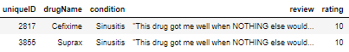
Exploratory Data Analysis
Missing Values
Repetitive Reviews
Condition:
1194 missing values
<1% of total set
Dropped given immateriality
Other Parameters:
None missing values
Same drug with more than one alias
Removed rows with duplicate reviews
Resulted in a total 128K rows of dataset

Slide 9
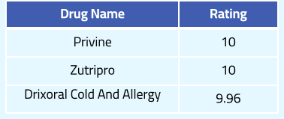
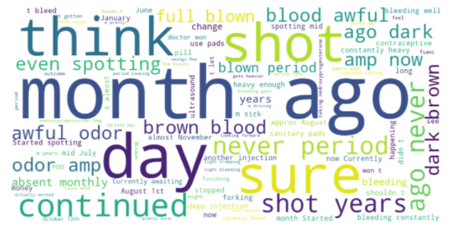
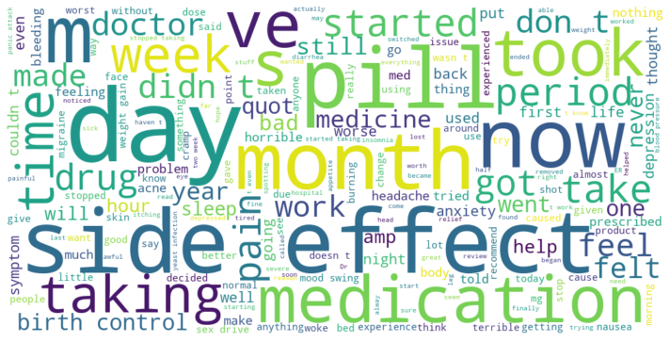
Exploratory Data Analysis
Average Rating
Overall Average Drug Rating: 7.12
Word Cloud
Overall
Negative Review Only

Slide 10
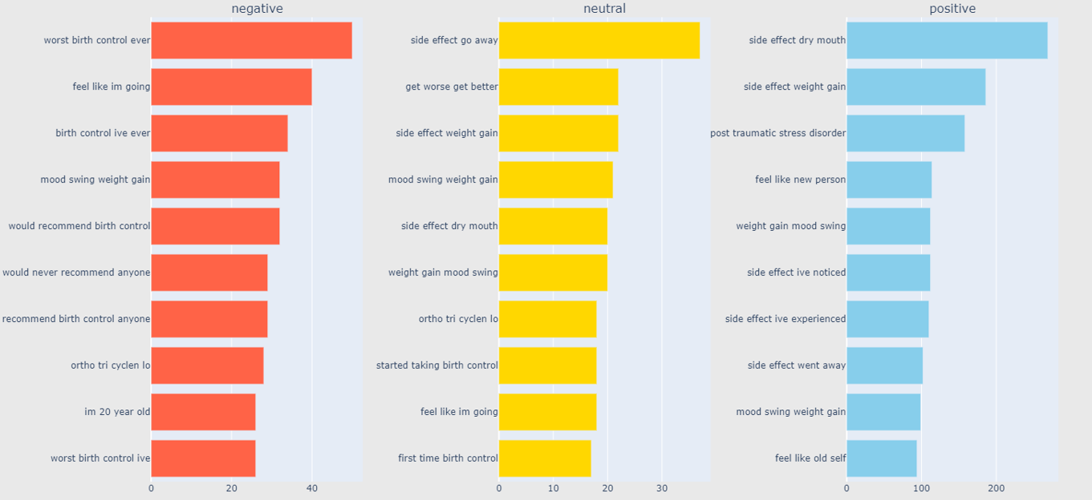

Exploratory Data Analysis
N-gram
Contiguous sequence of n items from a given sample of text
Try out starting with one item
Until 4-Gram, start to see interpretability of emotions, thus used for modeling

Slide 11
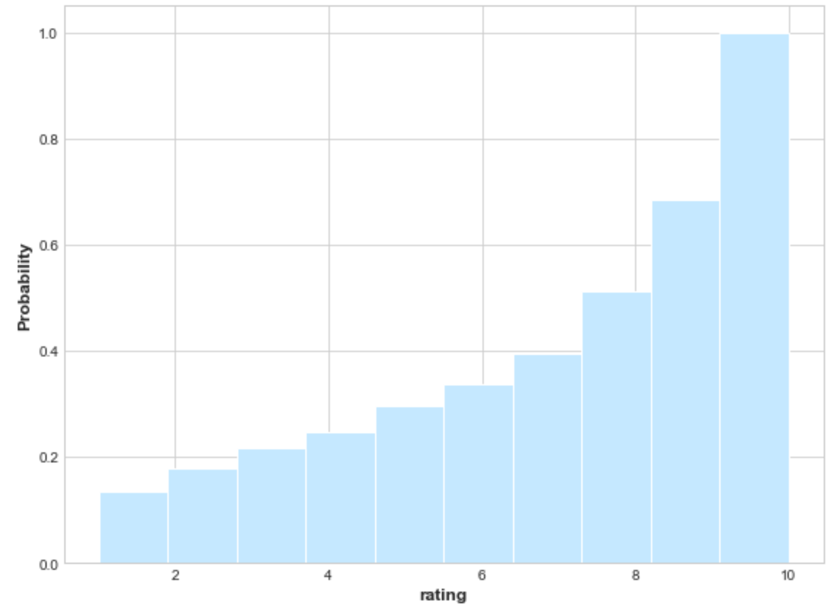
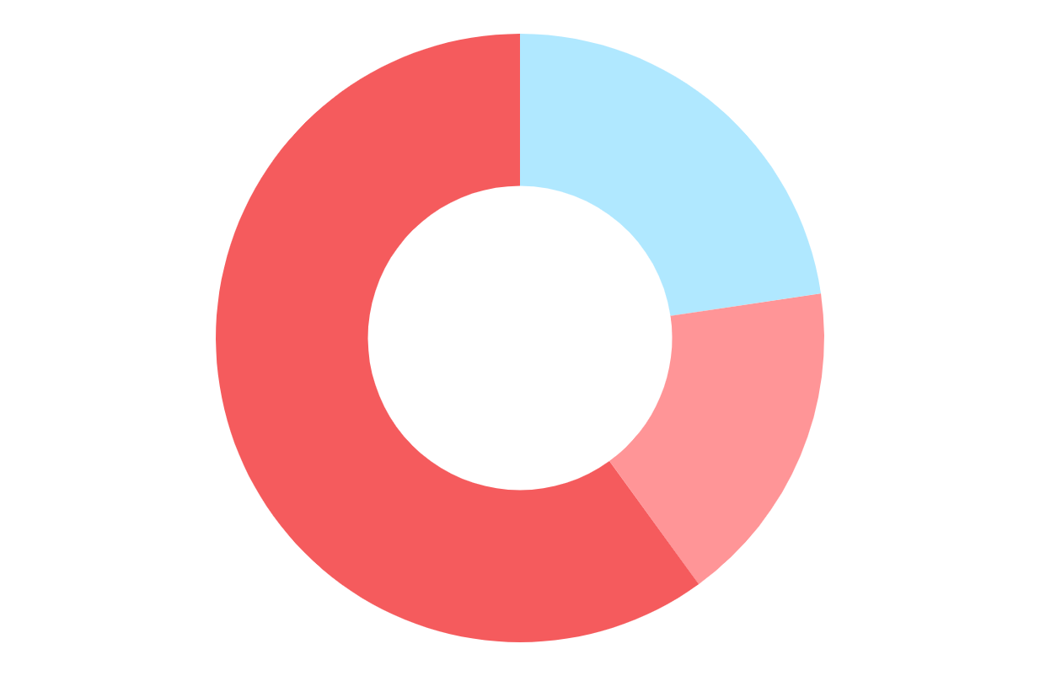
Feature Engineering
Ratings -> Sentiment Tag
“Negative”: 1~3
“Neutral”: 4~6
“Positive”: 7~10
Negative
21.7%
Positive
66.3%
11.9%
Neutral

Slide 12
Feature Engineering
Review Cleaning
Shrink multiple spaces into 1 space.
Only 2 pills make me feels better. –> Only 2 pills make me feels better.
Convert all of the characters to lowercase.
Only 2 pills make me feels better. –> only 2 pills make me feels better.
Replace digits with special identifier.
only 2 pills make me feels better. –> only DG pills make me feels better.
Drop reviews which length is more than 150. (<1%)
√

Slide 13
03
Modeling
Model Overview
Model Selection

Slide 14
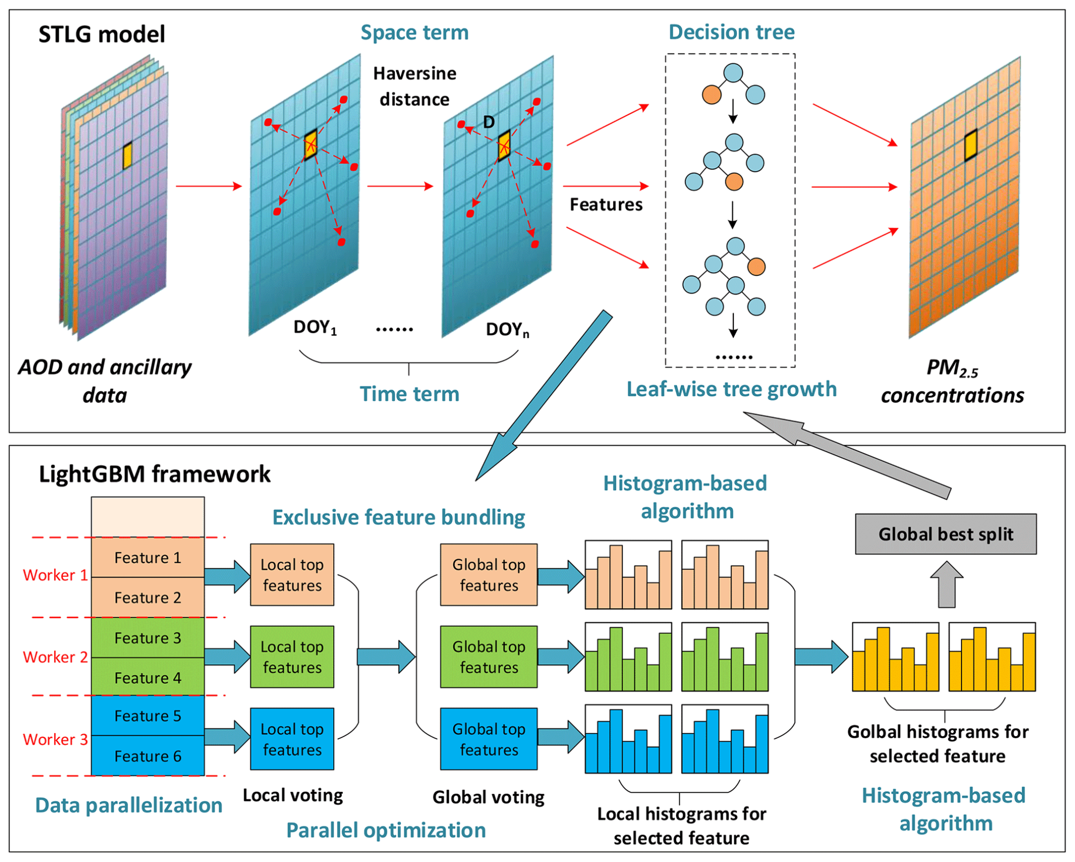
Model Overview
LightGBM
Introduction
Pros & Cons
Faster
Less Memory
Overfitting
Sensitive to outliers

Slide 15
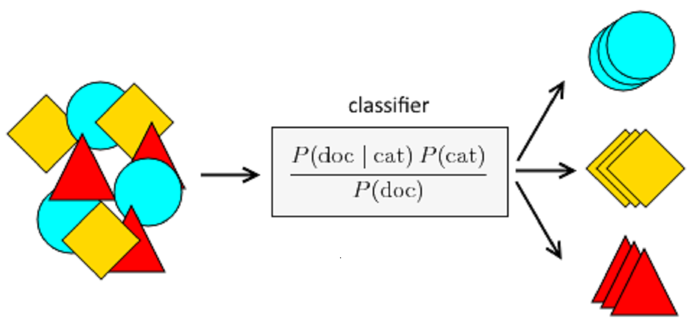
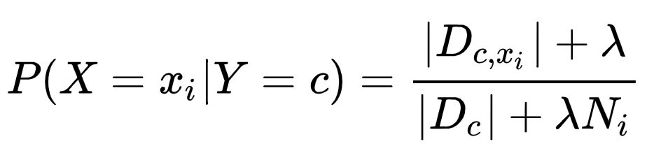
Model Overview
Naive Bayes
Introduction
Pros & Cons
Designed for text
Lot faster than the plan version
It is difficult to get the set of independent predictors

Slide 16
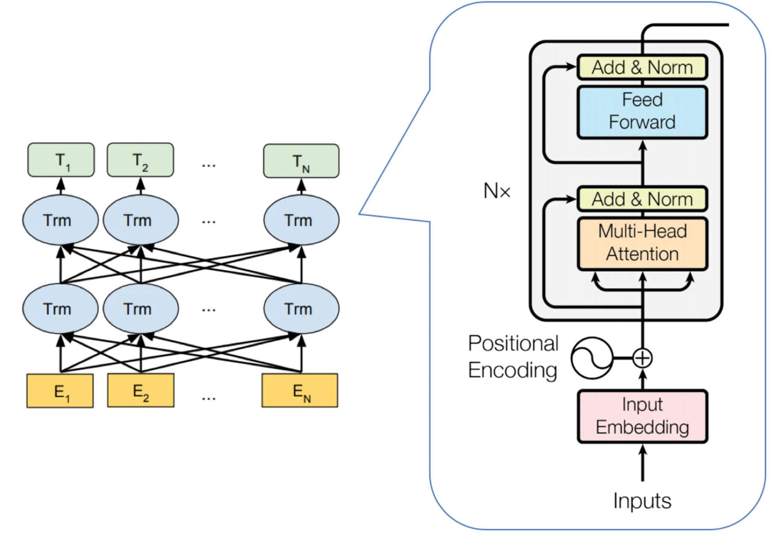
Model Overview
Bert
Introduction
Pros & Cons
Use bi-directional learning to gain context of words from both left to right context and right to left context
Maximum token length is 512, unable to document-level task
Difficult to do generative tasks
Assumption of independence

Slide 17
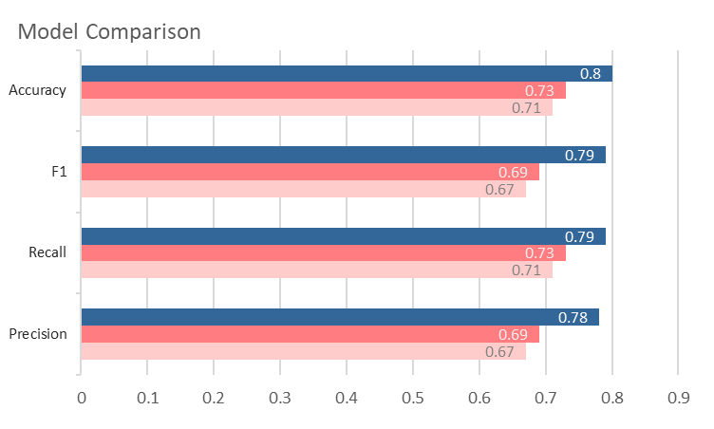
Model Selection
Best Model: BERT
Accuracy | 0.80 | Recall | 0.79
F1 | 0.79 | Precision | 0.78
Fine Tuning
Strategy: Transformer
Optimizer | Adams | lr | 1e-5
Epochs | 4 | Batchsize | 32
BERT
LightGBM
Naive Bayes

Slide 18
04
Conclusion
prescription
Healthcare Impact
Improvement Areas

Slide 19
Healthcare impact
Ensuring Medication Safety
Reducing medication errors for physicians
Post-Market Drug Surveillance for pharmco
Obtain valuable summaries of public opinion for FDA
Effectiveness Evaluation
Facilitating patients in making better informed purchase decision
Product marketing insights for pharmaco
Potential Drug Recommendation at prescription

Slide 20

Weakness Future Work
Model Selection Consideration
Attempt Bio-Bert and Clinical-Bert
Need more advanced and fit model/technique, misclassification of neutral reviews is high
Patients’ reviews may not use the same language as scientist & healthcare providers, but we need try to see how it actually performs
Little Improvement in Fine-Tuning
Learn & Practice
Fine-tuning doesn’t help improve the model performance a lot
Will try larger number of epochs like 5,10, and different learning rate etc.

Slide 21
Thanks!

